Slide 1
Department of Applied Mathematics and Computational Sciences
III Sem M.Sc.Software Systems
Transform Techniques
Dr. V. Suresh kumar

Slide 2
Convolution theorem

Slide 3
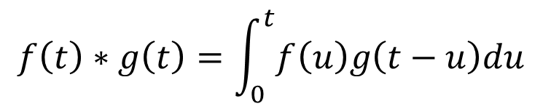

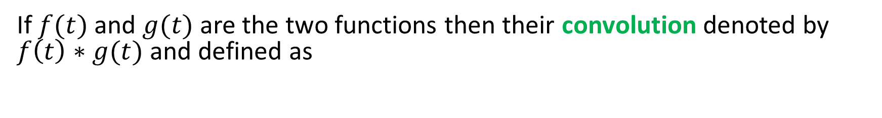



Definition
If $f(t)$ and $g(t)$ are the two functions then their convolution denoted by $f\left(t\right)∗g(t)$ and defined as
$$f\left(t\right)∗g\left(t\right)=\int_{0}^{t}{f\left(u\right)g\left(t−u\right)du}$$
$$g(u)$$
$$g(−u)$$
$$u$$
$$u$$

Slide 4
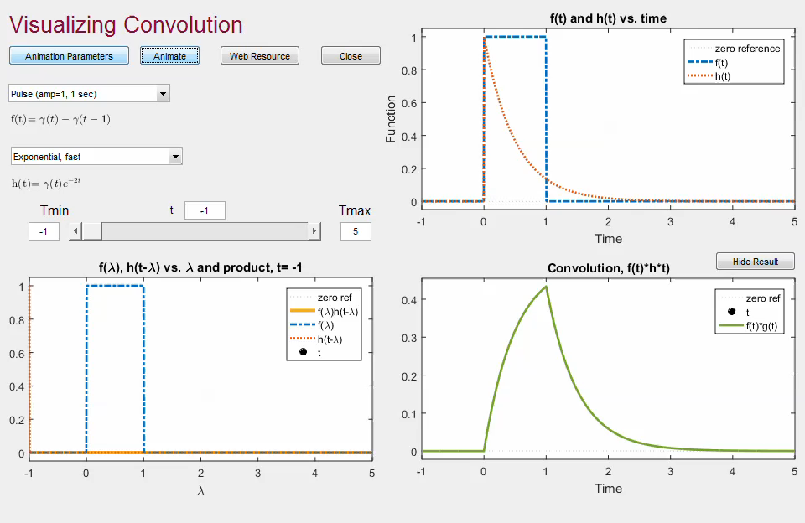
Geometrical interpretation
Blending of two functions
Area of overlapping
Amount of overlapping

Slide 5
Interpretation cont…

Slide 6
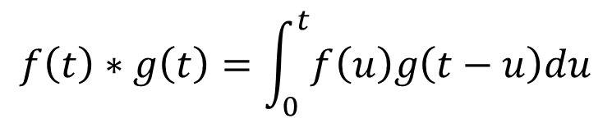


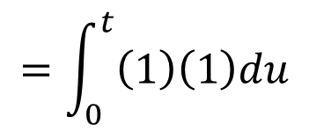
Problems
1. Find the convolution of $f\left(t\right)=1, g\left(t\right)=1$
Ans:
$$f\left(t\right)∗g\left(t\right)=\int_{0}^{t}{f\left(u\right)g\left(t−u\right)du}$$
$$=\int_{0}^{t}{\left(1\right)\left(1\right)du}$$
$$={\left[t\right]}_{0}^{t}$$
$$f\left(t\right)∗g\left(t\right)= t$$

Slide 7

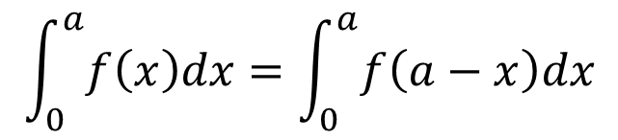
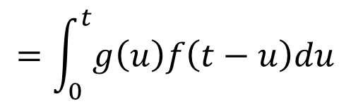
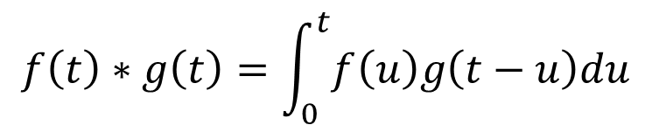
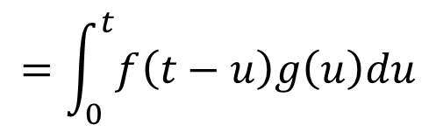
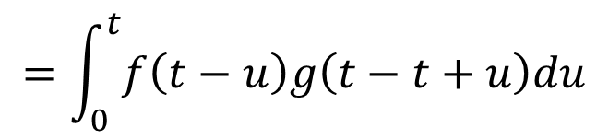
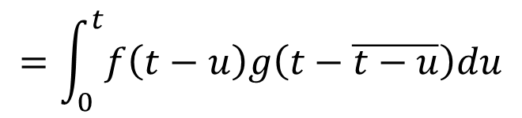
Property
Convolution is commutative
Proof:
$$f\left(t\right)∗g\left(t\right)=\int_{0}^{t}{f\left(u\right)g\left(t−u\right)du}$$
$$\int_{0}^{a}{f\left(x\right)dx}=\int_{0}^{a}{f\left(a−x\right)dx}$$
$$=\int_{0}^{t}{f\left(t−u\right)g\left(t−\overline{t−u}\right)du}$$
$$=\int_{0}^{t}{f\left(t−u\right)g\left(t−t+u\right)du}$$
In addition, convolution operation is
distributive and
associative
$$=\int_{0}^{t}{f\left(t−u\right)g\left(u\right)du}$$
$$=\int_{0}^{t}{g\left(u\right)f\left(t−u\right)du}$$
$$f\left(t\right)∗g(t)=g\left(t\right)∗f\left(t\right)$$
Thus, convolution operation is commutative

Slide 8



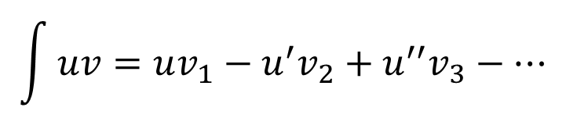
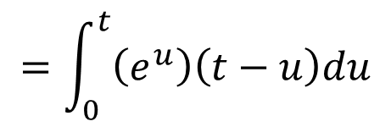
Problems
2. Find the convolution of $f\left(t\right)=e^{t}, g\left(t\right)=t$
Ans:
$$f\left(t\right)∗g\left(t\right)=\int_{0}^{t}{f\left(u\right)g\left(t−u\right)du}$$
$$\int{uv=uv_{1}−u^{′}v_{2}+u^{′′}v_{3}−…}$$
$$=\int_{0}^{t}{\left(e^{u}\right)\left(t−u\right)du}$$
$$={\left[\left(t−u\right)e^{u}−(−1)(e^{u})\right]}_{0}^{t}$$
$$=e^{t}−(t+1)$$
$$f\left(t\right)∗g\left(t\right)=e^{t}−t−1$$

Slide 9
Homework Problems
Compute the convolution for the following functions
(1)
(2)
(3)
(4)
(5)

Slide 10
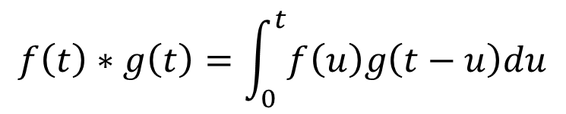
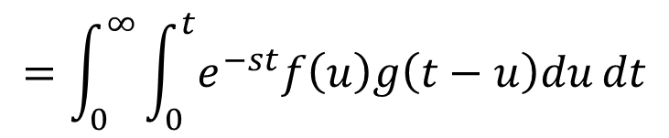
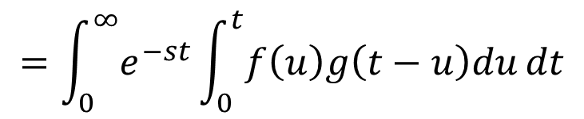
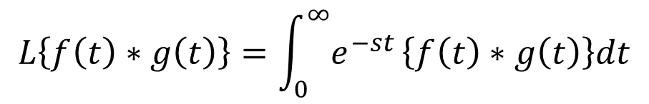

Convolution Theorem
If $L\left\{f\left(t\right)\right\}=F(s)$ and $L\left\{g\left(t\right)\right\}=G(s)$ then $L\left\{f\left(t\right)∗g\left(t\right)\right\}=F\left(s\right)G(s)$
Proof
We have
$$L\left\{f\left(t\right)\right\}=\int_{0}^{∞}{e^{−st}}f\left(t\right)dt$$
$$f\left(t\right)∗g\left(t\right)=\int_{0}^{t}{f\left(u\right)g\left(t−u\right)du}$$
$$L\left\{f\left(t\right)∗g\left(t\right)\right\}=\int_{0}^{∞}{e^{−st}}\left\{f\left(t\right)∗g\left(t\right)\right\}dt$$
$$=\int_{0}^{∞}{e^{−st}}\int_{0}^{t}{f\left(u\right)g\left(t−u\right)du}dt$$
$$=\int_{0}^{∞}{\int_{0}^{t}{e^{−st}f\left(u\right)g\left(t−u\right)du}}dt$$
Change the order of the integration

Slide 11





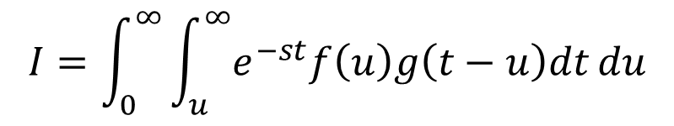
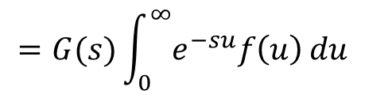
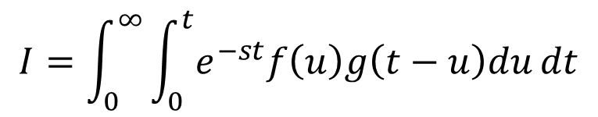
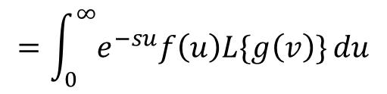



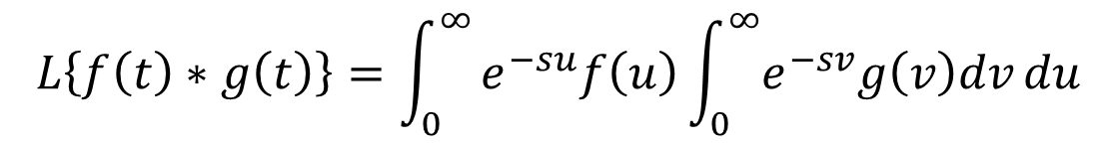



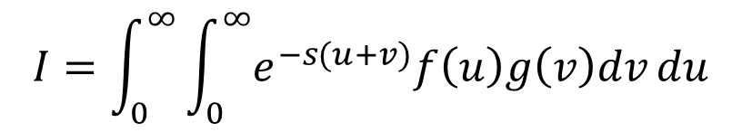
Proof cont…
$$u$$
Take
$$I=\int_{0}^{∞}{\int_{0}^{t}{e^{−st}f\left(u\right)g\left(t−u\right)du}}dt$$
$$u=t$$
$$t=0$$
$$u=0$$
$$t=0$$
$$u=t$$
$$t=∞$$
$$I=\int_{0}^{∞}{\int_{u}^{∞}{e^{−st}f\left(u\right)g\left(t−u\right)dt}}du$$
$$u=0$$
$$t$$
put
$$v=t−u$$
$$=\int_{0}^{∞}{e^{−su}f\left(u\right)L\{g\left(v\right)\}}du$$
$$I=\int_{0}^{∞}{\int_{0}^{∞}{e^{−s(u+v)}f\left(u\right)g\left(v\right)dv}}du$$
$$=G(s)\int_{0}^{∞}{e^{−su}f\left(u\right)}du$$
$$L\left\{f\left(t\right)∗g\left(t\right)\right\}=\int_{0}^{∞}{e^{−su}f\left(u\right)\int_{0}^{∞}{e^{−sv}g\left(v\right)dv}}du$$
$$L\left\{f\left(t\right)∗g\left(t\right)\right\}=G\left(s\right)F(s)$$

Slide 12
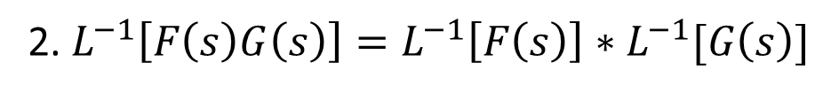
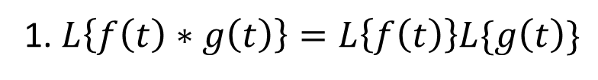
Note
1. $L\left\{f\left(t\right)∗g\left(t\right)\right\}=L\left\{f\left(t\right)\right\}L\{g\left(t\right)\}$
2. $L^{−1}\left[F\left(s\right)G\left(s\right)\right]=L^{−1}\left[F\left(s\right)\right]∗L^{−1}[G\left(s\right)]$

Slide 13

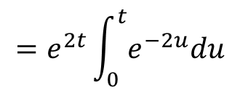
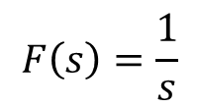

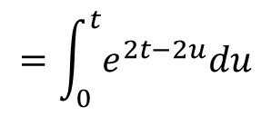
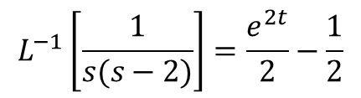
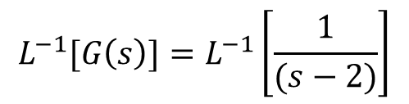
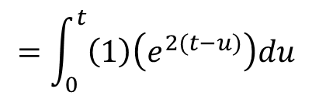
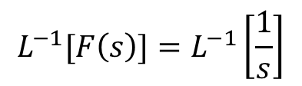
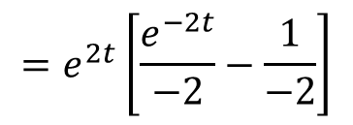

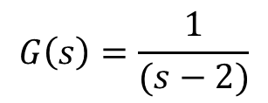

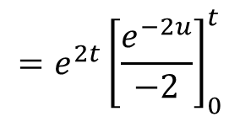
Problems
1. Find the Inverse Laplace Transform of $\frac{1}{s(s−2)}$
Ans:
$$=\int_{0}^{t}{e^{2t−2u}du}$$
Take
$$F\left(s\right)=\frac{1}{s}$$
$$G\left(s\right)=\frac{1}{(s−2)}$$
$$=e^{2t}\int_{0}^{t}{e^{−2u}du}$$
$$L^{−1}[F\left(s\right)]=L^{−1}\left[\frac{1}{s}\right]$$
$$L^{−1}[G\left(s\right)]=L^{−1}\left[\frac{1}{(s−2)}\right]$$
$$=1$$
$$=e^{2t}$$
$$=e^{2t}{\left[\frac{e^{−2u}}{−2}\right]}_{0}^{t}$$
$L^{−1}\left[F\left(s\right)G\left(s\right)\right]=L^{−1}\left[F\left(s\right)\right]∗L^{−1}[G\left(s\right)]$
$$=e^{2t}\left[\frac{e^{−2t}}{−2}−\frac{1}{−2}\right]$$
$L^{−1}\left[\frac{1}{s(s−2)}\right]=1∗e^{2t}$
$$L^{−1}\left[\frac{1}{s(s−2)}\right]=\frac{e^{2t}}{2}−\frac{1}{2}$$
$$=\int_{0}^{t}{\left(1\right)\left(e^{2(t−u)}\right)du}$$

Slide 14

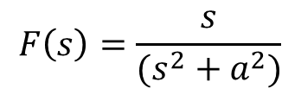

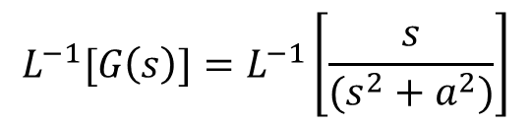
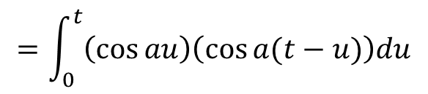
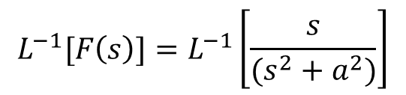
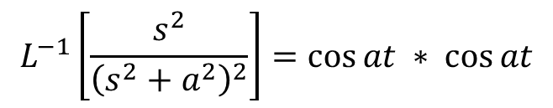
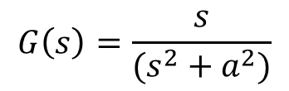

Problems cont…
2. Find the Inverse Laplace Transform of $\frac{s^{2}}{{\left(s^{2}+a^{2}\right)}^{2}}$
Ans
Take
$$F\left(s\right)=\frac{s}{(s^{2}+a^{2})}$$
$$G\left(s\right)=\frac{s}{(s^{2}+a^{2})}$$
$$L^{−1}[F\left(s\right)]=L^{−1}\left[\frac{s}{(s^{2}+a^{2})}\right]$$
$$L^{−1}[G\left(s\right)]=L^{−1}\left[\frac{s}{(s^{2}+a^{2})}\right]$$
$$=\cos{at}$$
$$=\cos{at}$$
$L^{−1}\left[F\left(s\right)G\left(s\right)\right]=L^{−1}\left[F\left(s\right)\right]∗L^{−1}[G\left(s\right)]$
$$L^{−1}\left[\frac{s^{2}}{{\left(s^{2}+a^{2}\right)}^{2}}\right]=\cos{at} ∗ \cos{at}$$
$$=\int_{0}^{t}{\left(\cos{au}\right)\left(\cos{a(t−u)}\right)du}$$

Slide 15
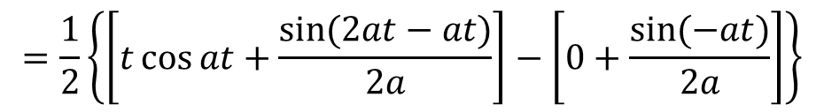
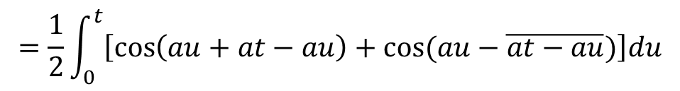
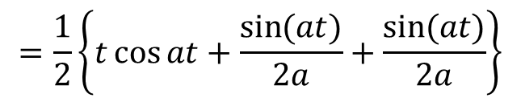
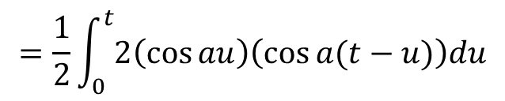
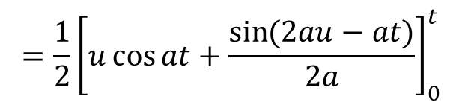
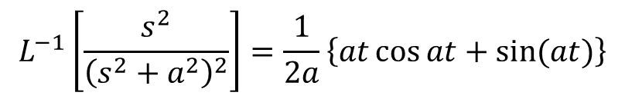
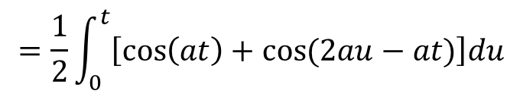
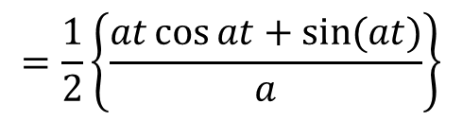
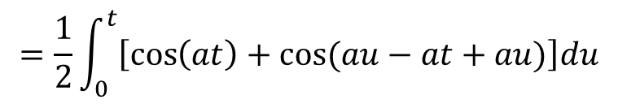

Problems cont…
$$=\frac{1}{2}\int_{0}^{t}{2\left(\cos{au}\right)\left(\cos{a(t−u)}\right)du}$$
$$=\frac{1}{2}\left\{t\cos{at}+\frac{\sin{(at)}}{2a}+\frac{\sin{(at)}}{2a}\right\}$$
$$=\frac{1}{2}\int_{0}^{t}{\left[\cos\left(au+at−au\right)+\cos{(au−\overline{at−au})}\right]du}$$
$$=\frac{1}{2}\left\{t\cos{at}+\frac{\sin{(at)}}{a}\right\}$$
$$=\frac{1}{2}\int_{0}^{t}{\left[\cos\left(at\right)+\cos{(au−at+au)}\right]du}$$
$$=\frac{1}{2}\left\{\frac{at\cos{at}+\sin{(at)}}{a}\right\}$$
$$=\frac{1}{2}\int_{0}^{t}{\left[\cos\left(at\right)+\cos{(2au−at)}\right]du}$$
$$L^{−1}\left[\frac{s^{2}}{{\left(s^{2}+a^{2}\right)}^{2}}\right]=\frac{1}{2a}\left\{at\cos{at}+\sin{(at)}\right\}$$
$$=\frac{1}{2}{\left[u\cos{at}+\frac{\sin{(2au−at)}}{2a}\right]}_{0}^{t}$$
$$=\frac{1}{2}\left\{\left[t\cos{at}+\frac{\sin{(2at−at)}}{2a}\right]−\left[0+\frac{\sin{(−at)}}{2a}\right]\right\}$$

Slide 16





Problems cont…
3. Find the Inverse Laplace Transform of $\frac{s}{{\left(s^{2}+a^{2}\right)}^{2}}$
Ans
Take
$$F\left(s\right)=\frac{1}{(s^{2}+a^{2})}$$
$$G\left(s\right)=\frac{s}{(s^{2}+a^{2})}$$
$$L^{−1}[F\left(s\right)]=L^{−1}\left[\frac{1}{(s^{2}+a^{2})}\right]$$
$$L^{−1}[G\left(s\right)]=L^{−1}\left[\frac{s}{(s^{2}+a^{2})}\right]$$
$$=\frac{1}{a}sin{at}$$
$$=\cos{at}$$
$L^{−1}\left[F\left(s\right)G\left(s\right)\right]=L^{−1}\left[F\left(s\right)\right]∗L^{−1}[G\left(s\right)]$
$$L^{−1}\left[\frac{s}{{\left(s^{2}+a^{2}\right)}^{2}}\right]=\frac{1}{a}sin{at} ∗ \cos{at}$$
$$=\frac{1}{a}\int_{0}^{t}{\left(\sin{au}\right)\left(\cos{a(t−u)}\right)du}$$

Slide 17









Problems cont…
$$=\frac{1}{2a}\left\{t\sin{at}−\frac{\cos\left(at\right)}{2a}+\frac{\cos{(at)}}{2a}\right\}$$
$$=\frac{1}{2a}\int_{0}^{t}{2\left(\sin{au}\right)\left(\cos{a(t−u)}\right)du}$$
$$=\frac{1}{2a}\left\{t\sin{at}\right\}$$
$$=\frac{1}{2a}\int_{0}^{t}{\left[\sin\left(au+at−au\right)+\sin{(au−\overline{at−au})}\right]du}$$
$$=\frac{1}{2a}\int_{0}^{t}{\left[\sin\left(au+at−au\right)+\sin{(au−at+au)}\right]du}$$
$$L^{−1}\left[\frac{s}{{\left(s^{2}+a^{2}\right)}^{2}}\right]=\frac{t}{2a}\sin{at}$$
$$=\frac{1}{2a}\int_{0}^{t}{\left[\sin\left(at\right)+\sin{(2au−at)}\right]du}$$
$$=\frac{1}{2a}{\left[u\sin{at}−\frac{\cos{(2au−at)}}{2a}\right]}_{0}^{t}$$
$$=\frac{1}{2a}\left\{\left[t\sin{at}−\frac{\cos{(2at−at)}}{2a}\right]−\left[0−\frac{\cos{(−at)}}{2a}\right]\right\}$$

Slide 18











Problems cont…
4. Solve the integral equation
$$y\left(t\right)−\int_{0}^{t}{y\left(τ\right)\sin\left(t−τ\right)dτ=t}$$
Ans
$$y\left(t\right)−\int_{0}^{t}{y\left(τ\right)\sin\left(t−τ\right)dτ=t}$$
$$L\{y\left(t\right)\}\left[\frac{s^{2}}{s^{2}+1}\right]=\frac{1}{s^{2}}$$
Given
$$y\left(t\right)−y\left(t\right)∗\sin{t}=t$$
$$L\{y\left(t\right)\} =\frac{s^{2}+1}{s^{4}}$$
Taking Laplace Transform on both sides
$$L\left\{y\left(t\right)\right\}=\frac{1}{s^{2}}+\frac{1}{s^{4}}$$
$$L\{y\left(t\right)\}−L\{y\left(t\right)∗\sin{t\}}=L\{t\}$$
$$L\left\{y\left(t\right)\right\}−L\left\{y\left(t\right)\right\}L\{\sin{t\}}=L\{t\}$$
$$y\left(t\right)=t+\frac{t^{3}}{3!}$$
$$L\{y\left(t\right)\}\left[1−\frac{1}{s^{2}+1}\right]=\frac{1}{s^{2}}$$
$$L\{y\left(t\right)\}\left[\frac{s^{2}+1−1}{s^{2}+1}\right]=\frac{1}{s^{2}}$$

Slide 19









Problems cont…
5. Solve the integral equation
$$y\left(t\right)−\int_{0}^{t}{\left(1+τ\right)y\left(t−τ\right)dτ=1−\sinh{t}}$$
Ans
$$L\{y\left(t\right)\}\left[\frac{s^{2}−s−1}{s^{2}}\right]=\frac{1}{s}−\frac{1}{s^{2}−1}$$
$$y\left(t\right)−\int_{0}^{t}{\left(1+τ\right)y\left(t−τ\right)dτ=1−\sinh{t}}$$
Given
$$y\left(t\right)−y\left(t\right)∗(1+t)=1−\sinh{t}$$
$$L\{y\left(t\right)\}\left[\frac{s^{2}−s−1}{s^{2}}\right]=\frac{s^{2}−s−1}{s\left(s^{2}−1\right)}$$
Taking Laplace Transform on both sides
$$L\{y\left(t\right)\}−L\{y\left(t\right)∗\left(1+t\right)\}=L\{1\}−L\{\sinh{t\}}$$
$$L\{y\left(t\right)\} =\frac{s}{\left(s^{2}−1\right)}$$
$$L\{y\left(t\right)\}−L\left\{y\left(t\right)\right\}L\{1+t\}=L\{1\}−L\{\sinh{t\}}$$
$$L\{y\left(t\right)\}\left[1−\overline{\frac{1}{s}+\frac{1}{s^{2}}}\right]=\frac{1}{s}−\frac{1}{s^{2}−1}$$
$$L\{y\left(t\right)\} =\cosh{t}$$
$$L\{y\left(t\right)\}\left[1−\frac{1}{s}−\frac{1}{s^{2}}\right]=\frac{1}{s}−\frac{1}{s^{2}−1}$$

Slide 20

Homework problems
Find the Inverse Laplace Transform for the following
$$\frac{1}{{\left(s^{2}+a^{2}\right)}^{2}}$$
(i)
(ii)
Solve the following integral equations
(i)
(ii)
(iii)
(iv)

Slide 21


